Slide 1
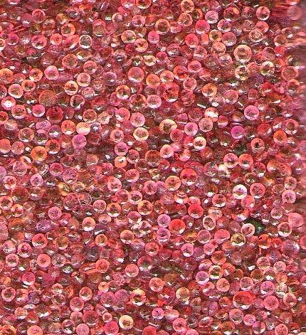
Object-oriented Programming with Ruby
Robert Batzinger
CSCI A-201
Spring 2009

Slide 2
The Fixnum, Bignum, Float and Math Classes:
Working with numbers

Slide 3
Three types of numbers
Class name | Description
Fixnum | Integers of computer word length in the range of -1073741824 to 1073741823
Bignum | Huge integers of no limit stored in a variable number of byte
Float | Double precision floating point with 15 digits of precision handling numbers ranging from 2.22507e-308 to 1.79769e+308

Slide 4
Class constants
Value | Syntax | Value
Largest float | Float::MAX | 1.79769313486232e+308
Smallest float | Float::MIN | 2.2250738585072e-308
Number of digits | Float::DIG | 15
Smallest increment | Float::EPSILON | 2.22044604925031e-016
pi | Math::PI | 3.14159265358979
e | Math::E | 2.71828182845905

Slide 5
Common operations
Arithmetic
Bit operations (Fixnum)
+ Addition
- Subtraction
* Multiplication
/ Division
% Modulo
** Exponentiation
- Invert bits
| Bitwise OR
& Bitwise AND
^ Bitwise Exclusive OR
<< Left-Shift
>> Right-Shift

Slide 6
Common methods
abs – absolute value -5.abs 5
ceil -- round up (4.1).ceil 5
floor – round down (4.1).floor 4
Round – round (4.8) 5
to_s – convert to string (4.8).to_s “4.8”
to_i – convert to integer (4.8).to_i 4
to_f – convert to a float 4.to_f 4.0

Slide 7
Math methods
acos
acosh
asin
asinh
atan
atan2
atanh
cos
cosh
erf
erfc
frexp
hypot
ldexp
log
log10
rsqrt
sin
sinh
sqrt
tan
tanh

Slide 8
おわり The end

